Slide 1
Security Policies

Slide 2
Learning Objectives
What is Information Security Policies ?
What are the purposes of Information security policies?
Types of Information Security Policies.
Components of Effective Policies.
Password Policy.
Acceptable Use Policy.
Data Classification Policy

Slide 3
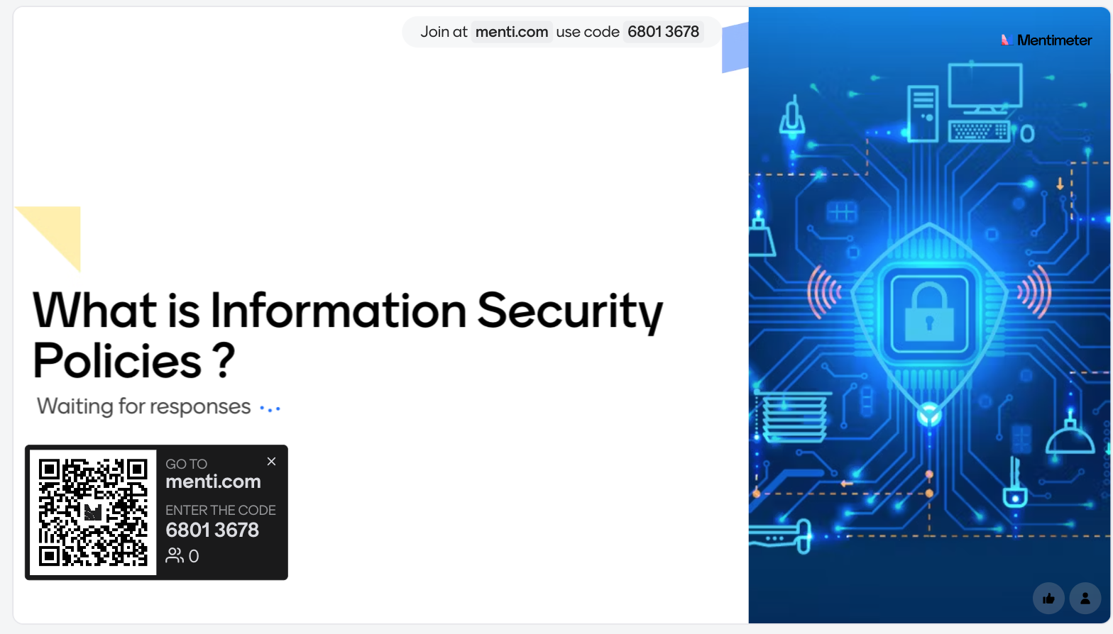
What is Information Security Policies ?
Notes:
Encryption
Decryption
Security
Confidentiality
Algorithms
Keys
Ciphers
Privacy
Cryptanalysis
Protection
Information
Communication
Confidential
Authentication
Integrity
Cryptosystem
Key exchange

Slide 4
What is Information Security Policies ?
Information security policies are formal documents or statements that outline an organization's approach to protecting its information assets.
provide guidelines, rules, and procedures that employees and must follow to maintain the confidentiality, integrity, and availability of sensitive data.
Notes:
Communication is the process of exchanging information
set of rules designed to perform a specific task or solve a particular problem.

Slide 5
What are the purposes of Information security policies?
The primary purpose of information security policies is to reduce the risk of security breaches and data leaks.
Establishing clear expectations and responsibilities for everyone within the organization.
It helps to make one standard of security practices and ensure that employees are aware of the organization's security requirements.
Notes:
Communication is the process of exchanging information
set of rules designed to perform a specific task or solve a particular problem.

Slide 6
Types of Information Security Policies
Information security policies can cover a wide range of topics
Access Control Policy: Defines rules for Providing and allowing access to systems and data.
Data Classification Policy: Establishes criteria for classifying data based on its sensitivity.
Password Policy: Specifies guidelines for creating and managing passwords.
Notes:
Communication is the process of exchanging information
set of rules designed to perform a specific task or solve a particular problem.

Slide 7
Types of Information Security Policies
Information security policies can cover a wide range of topics
Incident Response Policy: Outlines steps to be taken in case of a security incident or breach.
Acceptable Use Policy: Defines how employees are allowed to use company resources, including computers and networks.
Remote Access Policy: Sets rules for secure remote access to company systems.
BYOD (Bring Your Own Device) Policy: Covers the use of personal devices for work purposes.
Notes:
Communication is the process of exchanging information
set of rules designed to perform a specific task or solve a particular problem.

Slide 8
Components of Effective Policies
Information security policies can cover a wide range of topics
Policy Statement: A clear and concise explanation of the policy's purpose and scope.
Acceptable Use Policy: Defines how employees are allowed to use company resources, including computers and networks.
Remote Access Policy: Sets rules for secure remote access to company systems.
BYOD (Bring Your Own Device) Policy: Covers the use of personal devices for work purposes.
Notes:
Communication is the process of exchanging information
set of rules designed to perform a specific task or solve a particular problem.

Slide 9

Password Policy
Password policy: is a set of rules and guidelines that an organization establishes to ensure the security of user passwords.
Passwords are a critical element of access control and authentication, and a strong password policy helps protect sensitive information and systems from unauthorized access.
Notes:
Communication is the process of exchanging information
set of rules designed to perform a specific task or solve a particular problem.

Slide 10

key components of a password policy
Password Complexity:
Passwords should be complex and difficult to guess.
A typical policy might require a combination of uppercase and lowercase letters, numbers, and special characters.
Passwords should be of a minimum length, often between 8 to 12 characters or more.
Notes:
Communication is the process of exchanging information
set of rules designed to perform a specific task or solve a particular problem.

Slide 11
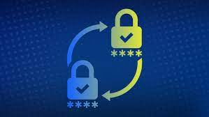
key components of a password policy
Password Rotation:
Passwords should be changed regularly to reduce the risk of unauthorized access due to compromised credentials.
Organizations may specify a maximum password age, after which users must reset their passwords.
.
Notes:
Communication is the process of exchanging information
set of rules designed to perform a specific task or solve a particular problem.

Slide 12
key components of a password policy
Password History:
To prevent users from reusing old passwords, password policies may maintain a password history.
Users are typically prevented from using their previous few passwords.
Account Lockout Policy:
Implement account lockout mechanisms to prevent brute-force attacks.
After a certain number of failed login attempts, the account can be temporarily locked or require manual unlocking by an administrator.
.
Notes:
Communication is the process of exchanging information
set of rules designed to perform a specific task or solve a particular problem.

Slide 13
key components of a password policy
Minimum Password Attempts:
Set a threshold for the number of failed login attempts allowed before an account is locked or temporarily disabled.
Password Recovery and Reset:
Specify procedures for password recovery or reset, which should involve secure methods of identity verification to prevent unauthorized access to accounts.
Password Storage:
Passwords should never be stored in plain text. Instead, they should be securely hashed before storage.
.
Notes:
Communication is the process of exchanging information
set of rules designed to perform a specific task or solve a particular problem.

Slide 14
key components of a password policy
User Education :
Ensure that users are educated about the importance of strong passwords and the organization's password policy.
Password Recovery:
Establish a secure process for users to recover their passwords, such as answering security questions or providing an alternate email address.
Regular Policy Review and Updates:
Continuously evaluate and update the password policy to adapt to evolving threats and best practices.
Notes:
Communication is the process of exchanging information
set of rules designed to perform a specific task or solve a particular problem.

Slide 15

Data Classification Policy
Data classification policy is a critical component of an organization's information security framework.
It provides guidelines and procedures for classifying and handling data based on its sensitivity and importance.
Notes:
Communication is the process of exchanging information
set of rules designed to perform a specific task or solve a particular problem.

Slide 16
key components of Data Classification Policy
Data Classification Levels:
Define specific data classification levels or categories based on sensitivity and criticality. Common classifications include:
Public: Information that can be freely shared with the public.
Internal Use Only: Data intended for use within the organization but not publicly shared.
Confidential: Highly sensitive data that requires strict access controls.
Restricted: Extremely sensitive data with limited access and security controls.
Notes:
Communication is the process of exchanging information
set of rules designed to perform a specific task or solve a particular problem.

Slide 17
key components of Data Classification Policy
Data Handling Guidelines:
Specify how each classification level of data should be handled, stored, transmitted, and disposed of. This includes encryption requirements, access controls
Data Encryption:
Specify encryption requirements for data in transit and data at rest, especially for highly sensitive data.
Access Controls:
Define who has access to each classification level of data and the methods for access rights.
Notes:
Communication is the process of exchanging information
set of rules designed to perform a specific task or solve a particular problem.

Slide 18
key components of Data Classification Policy
Data Transfer and Sharing:
Outline rules for sharing data with external parties, including the use of secure channels and agreements to protect data confidentiality and integrity.
Training and Awareness:
Ensure that employees are educated about the data classification policy and understand their roles and responsibilities in safeguarding classified data.
Incident Response:
Include procedures for reporting and responding to security incidents involving classified data.
Notes:
Communication is the process of exchanging information
set of rules designed to perform a specific task or solve a particular problem.

Slide 19
key components of Data Classification Policy
Regular Policy Review and Updates:
Periodically review and update the policy to accommodate changes in technology, threats, and organizational needs.
Integration with Other Policies:
Ensure that the data classification policy is integrated with other information security policies, such as access control and encryption policies.
Notes:
Communication is the process of exchanging information
set of rules designed to perform a specific task or solve a particular problem.

Slide 20
Acceptable Use Policy
Acceptable Use Policy (AUP), is a crucial document for organizations to define the acceptable and responsible use of their information technology resources.
This policy establishes guidelines and rules for employees and users to ensure that IT resources are used securely.
Notes:
Communication is the process of exchanging information
set of rules designed to perform a specific task or solve a particular problem.

Slide 21
key components of Acceptable Use Policy
Policy Statement:
Begin with a clear and concise policy statement that explains the purpose and scope of the policy.
Authorized Users:
Specify who is covered by the policy, including employees, contractors, third-party vendors, and any other individuals or entities with access to the organization's IT resources.
Overview of IT Resources:
Define the IT resources covered by the policy, which may include computers, networks, servers, software, email systems, internet access, and any other technology assets.
Notes:
Communication is the process of exchanging information
set of rules designed to perform a specific task or solve a particular problem.

Slide 22
key components of Acceptable Use Policy
Acceptable Use Guidelines:
Provide detailed guidelines on what is considered acceptable use of IT resources. This should cover areas such as:
Appropriate and ethical use of email and communication tools.
Not allowed activities, such as hacking, unauthorized access, or distribution of malicious software.
Guidelines for accessing and using the internet, including restrictions on visiting potentially harmful or unsuitable websites.
Restrictions on using IT resources for personal activities or financial gain.
Respect for copyrights and intellectual property rights.
Notes:
Communication is the process of exchanging information
set of rules designed to perform a specific task or solve a particular problem.

Slide 23
What’s next on the agenda?
Break: 20 minutes
Lab Explanation
Lab Work

Slide 24


